Slide 1

BLDC MOTOR DRIVE MODELLING FOR AUTOMOTIVE APPLICATION
HEVD-ECE512
GUIDED BY:
Dr. MAHESH KRISHNAMURTHY
PRESENTED BY:
Er. ANIRUDHA BEHERA
Er. SHUBHAM PRAJAPATI
Er. ANUVA AGARWAL
DEPT. OF ELECTRICAL ENGINEERING

Slide 2
ABSTRACT
1
The Brushless DC (BLDC) motor is the ideal choice for applications that require high reliability, high efficiency, and high power-to-volume ratio. BLDC motor are now a days becoming popular in electric vehicles, fuel pumps, medical equipment, printers, different domestic appliances, industrial and aerospace applications; because of its light weight, high operating speed and excellent speed-torque characteristics. The motor is operated in four steady state operating modes of torque-speed plane. To control a BLDC machine it is generally required to measure the speed and position of rotor by using the sensor because the inverter phases, acting at any time, must be commutated depending on the rotor position. Simulation of the proposed model was done using MATHWORK’s MATLAB/ SIMULINK.
Key Words: BLDC (Brush less dc motor), PID controller, Hall Sensor, MOSFET Bridge

Slide 3
INTRODUCTION
In today’s market top cars are having more than 40 electrical machines, the global demand for motor drives are rapidly rising. Especially for Brushless DC (BLDC)) drives as BLDC are essential parts of Hybrid Electric Vehicle (HEV) and Electric Vehicle (EV) propulsion systems towards which priorities globally seem to be directed. BLDC drives are also employed where higher power and better regulation is needed in internal combustion vehicles. Some of the key automotive applications for electrical machines and drives are shown in Fig. 1.
Motor applications can be implemented in any of the three main categories shown below:
1. Powertrain – Energy related – key aspect is Performance.
2. Chassis and Safety – Safety and Comfort – key aspect is Reliability.
3. Body control – Ease of use and Lighting – key aspect is Cost.

Slide 4
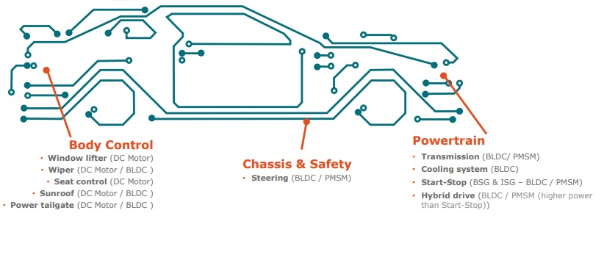
Cont.…

Slide 5
Control Schemes for BLDC Motor
We have used variable dc link voltage control scheme for speed control in our system . Also the hysteresis current control and carrier based control scheme are used for controlling the gate pulse of the inverter. BLDC Motor can also be controlled by controlling the dc bus voltage or by PWM method. Some designs utilize both to provide high torque at high load and high efficiency at low load. Such hybrid designs also allows the control of harmonic current. The block diagram of differential control schemes for BLDC Motor drive strategies is shown below Figure.

Slide 6
PROPOSED SYSTEM
2
The control of three phase Brushless DC (BLDC) motor PID controller is proposed here. By using the proposed method, A smooth transition between the quadrants is achieved. The time taken to change the direction of rotation of BLDC motor is also comparatively reduced.
In existed system, the frequent change of direction of rotation and hence the change of quadrants results in frequent braking. During braking time the kinetic energy is wasted as heat energy. Brushless DC Motors are driven by DC voltage but current commutation is controlled by solid state switches. The commutation instants are determined by the rotor position. The rotor shaft position is sensed by a Hall Effect sensor, which provides signals to the respective switches.
Whenever the rotor magnetic poles pass near the Hall sensors, they give a high or low signal, indicating either N or S pole is passing near the sensors. Based on the combination of these three Hall sensor signals, the exact sequence of commutation can be determined. These signals are decoded by combinational logic to provide the firing signals for 120 conduction on each of the three phases.
Hall Effect sensors are used to ascertain the rotor position and from the Hall sensor outputs, it is determined whether the machine has reversed its direction. This is the ideal moment for energizing the stator phase so that the machine can start motoring in the counter clockwise direction.

Slide 7
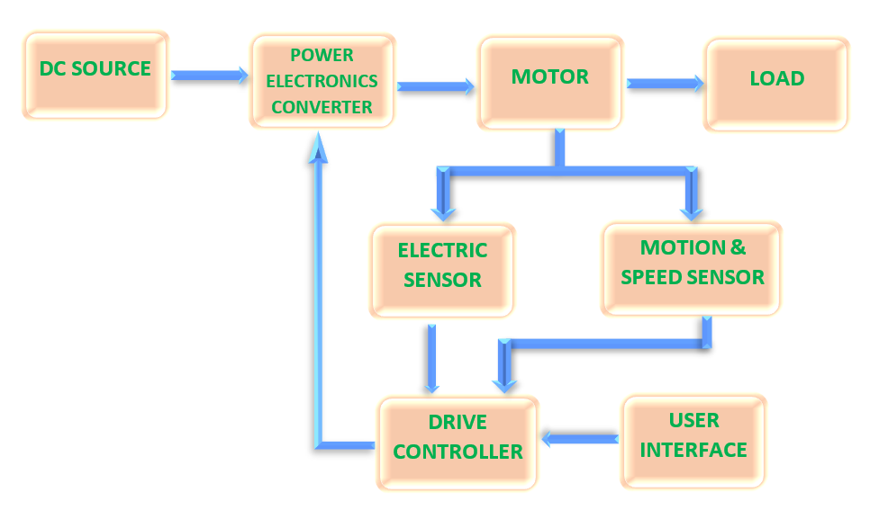
Cont.…
3
BLOCK DIAGRAM OF PROPOSED BLDC MOTOR CONTROL CYCLE:

Slide 8
Cont.…
4
The basic block diagram of BLDC motor control consist power converter, permanent magnet-synchronous machine (PMSM) sensors, and control algorithm. Three phase inverter transforms power from the source to the PMSM which in turn converts electrical energy to mechanical energy. BLDC motor has rotor position sensors controlled by the command signals , the command signal may be classified as torque , voltage , speed command and so on.
The type of the BLDC motor is determined by the structure of the control algorithms due to which there are two main types; voltage source and current source based drives.
The inverter size and losses for the same power size is reduced by the Machine with a non-sinusoidal back-Emf. The BLDC motor can be classified into two types according to the back-Emf signal such as sinusoidal back-Emf type or Trapezoidal back-Emf type.
We are using here Trapezoidal back-Emf type.

Slide 9
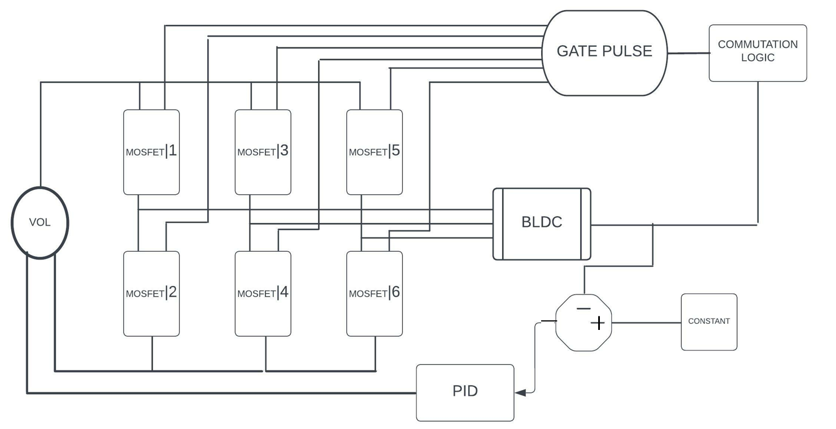
BLOCK DIAGRAM OF proposed BLDC DRIVE SYSTEM

Slide 10
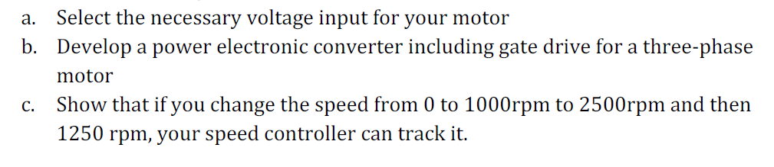
OPERATION
According to our application we have to perform three cases,
Case-1: Change speed from 0 to 1000rpm.
Case-2: Change speed from 1000rpm to 2500rpm.
Case-3: Change speed from 2500 to 1250rpm.

Slide 11
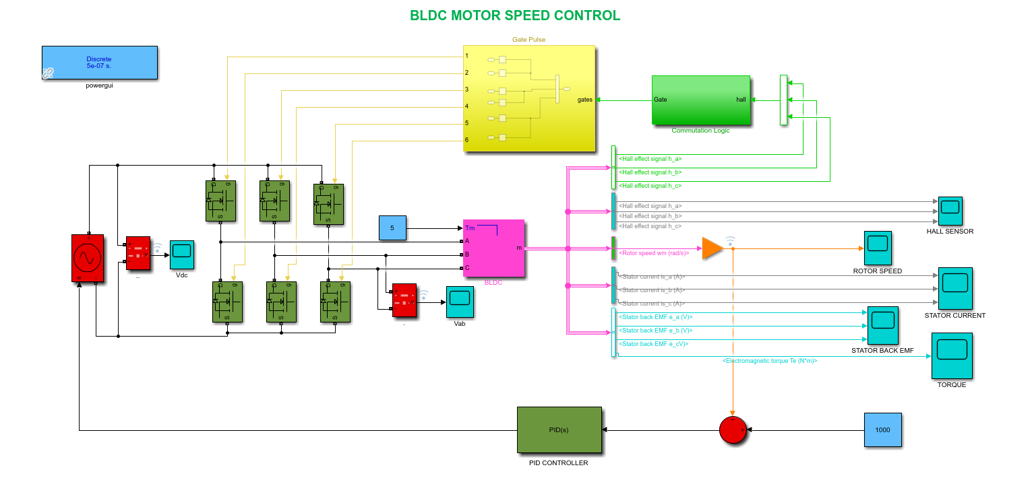
SIMULINK MODEL

Slide 12
Cont.…
BLDC MOTOR SPECIFICATIONs
PARAMETERS | VALUE | UNIT
STAOR PHASE RESISTANCE | 0.7 | Ω
STATOR PHASE INDUCTANCE | 0.027 | H
FLUX LINKAGE | 0.1194 | Wb
INERTIA (J) | 0.002 | Kg.m^2
VISCOUS DAMPING (F) | 0.0004924 | N.m.s
STATIC FRICTION (Tf) | 0 | N.m
POLES (P) | 4 | Numbers

Slide 13
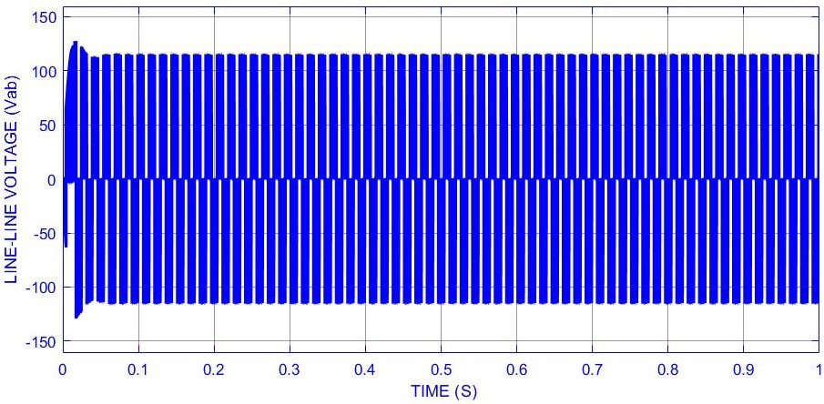
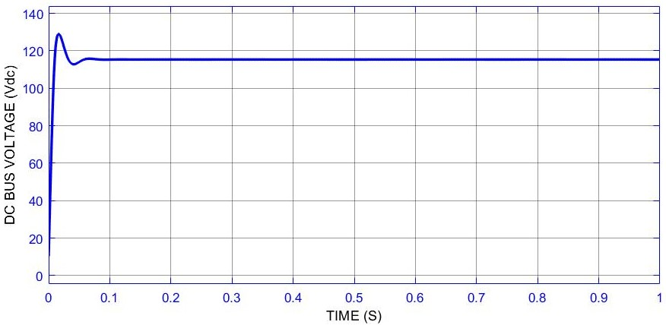
Cont.…
Case-1: Change speed from 0 to 1000rpm:

Slide 14
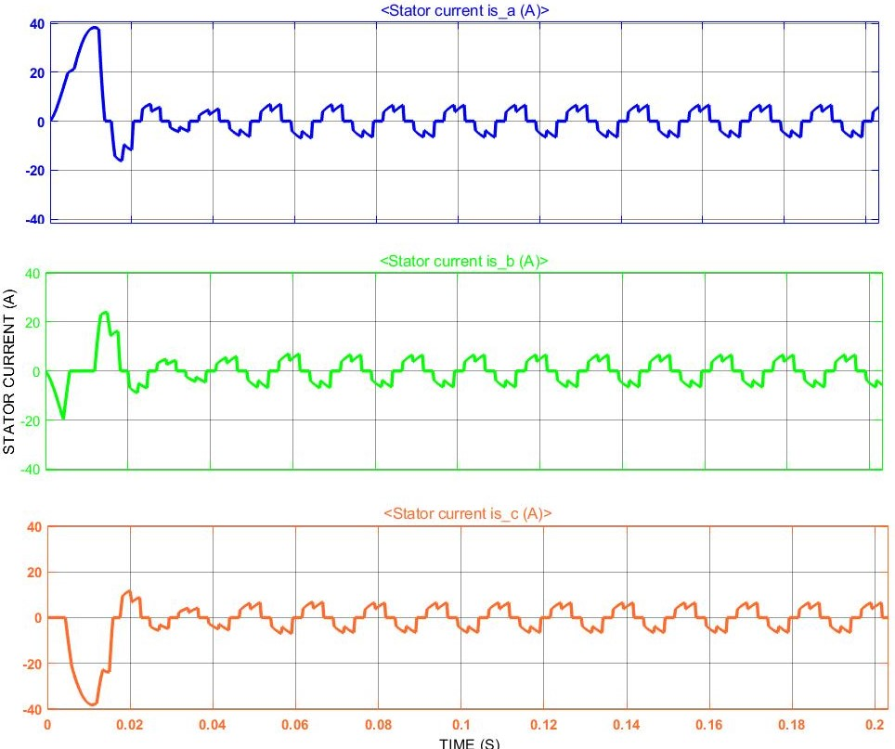
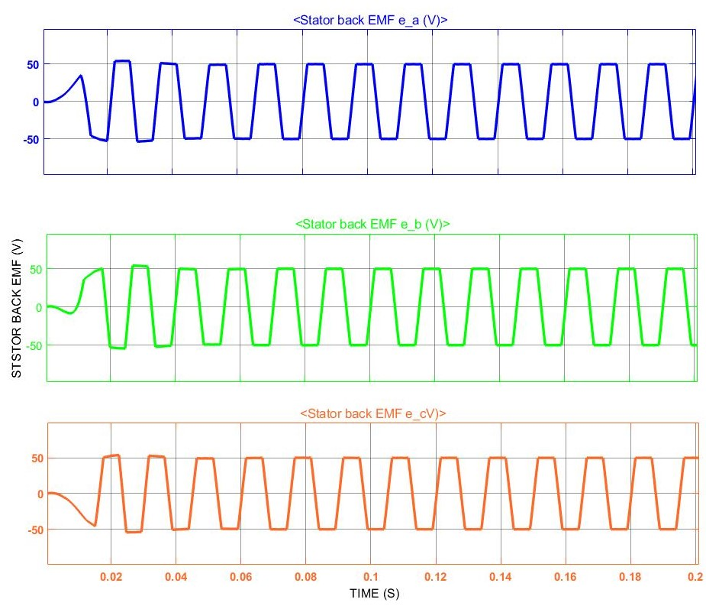
Cont.…

Slide 15
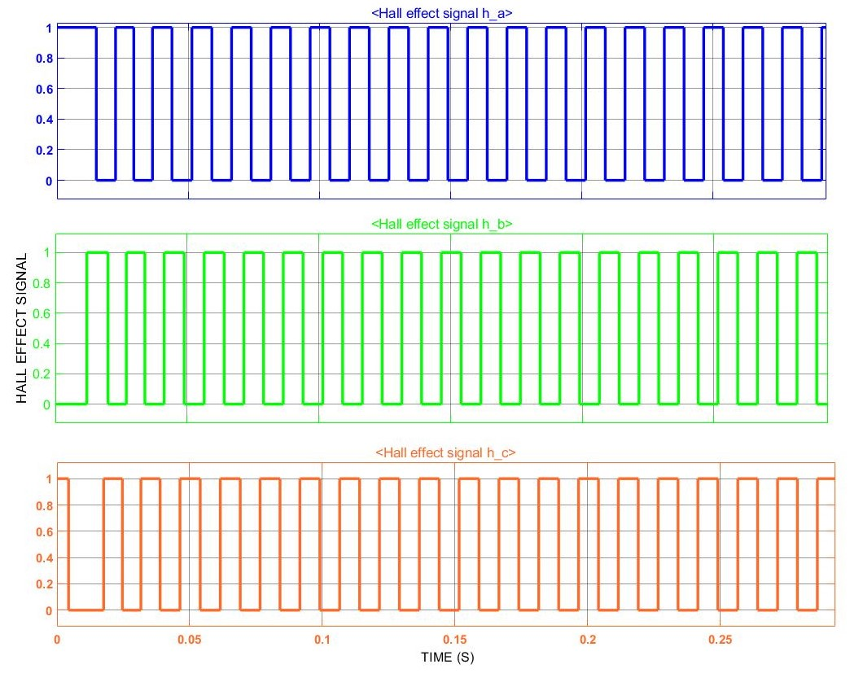
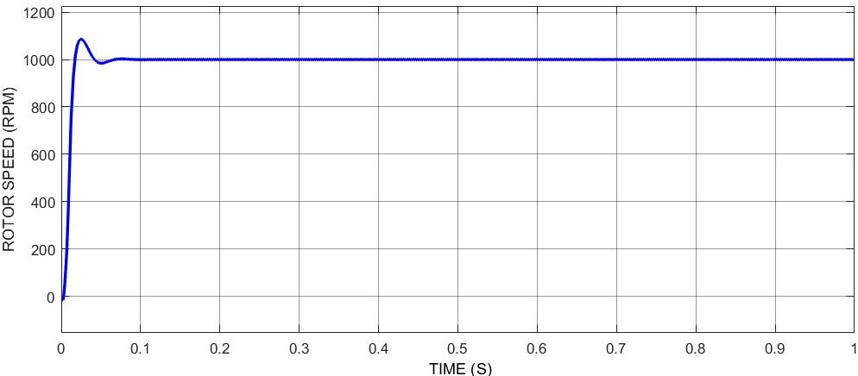
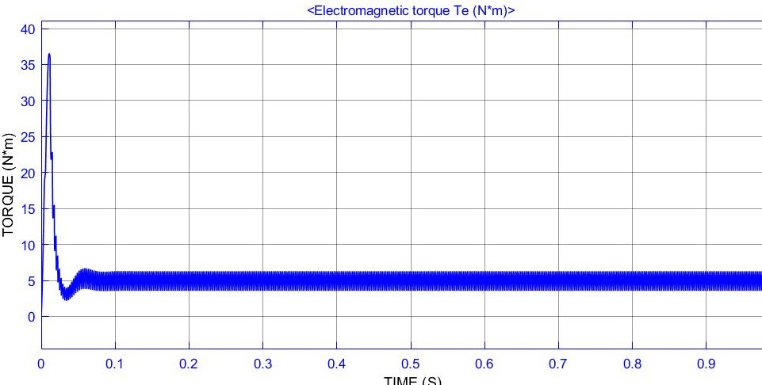
Cont.…

Slide 16
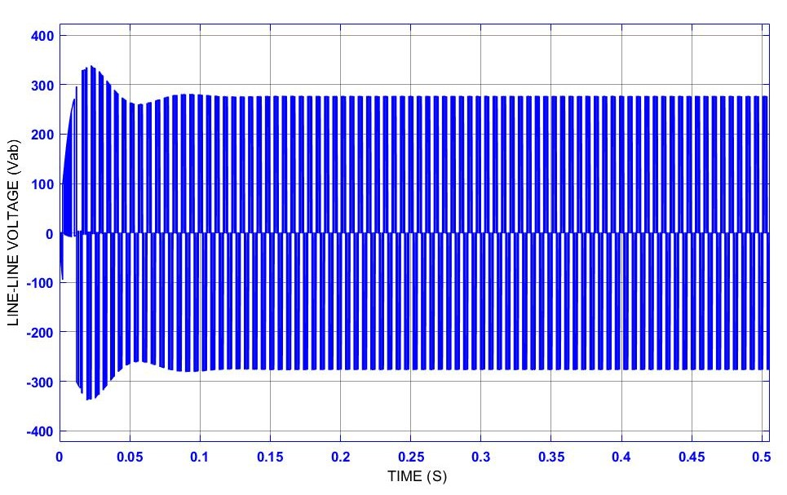
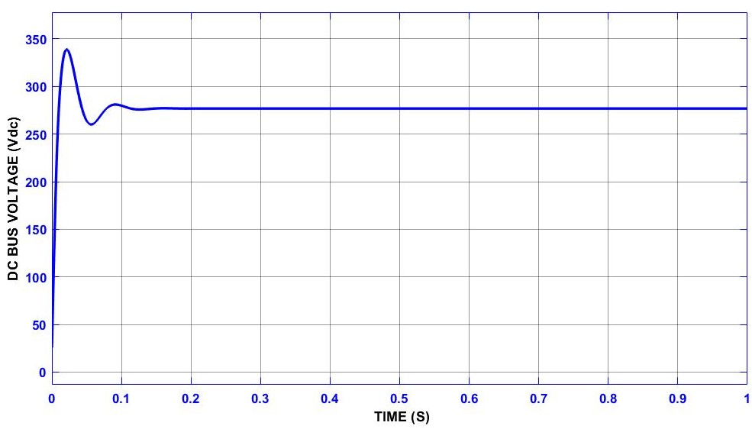
Cont.…
Case-2: Change speed from 1000rpm to 2500rpm:

Slide 17
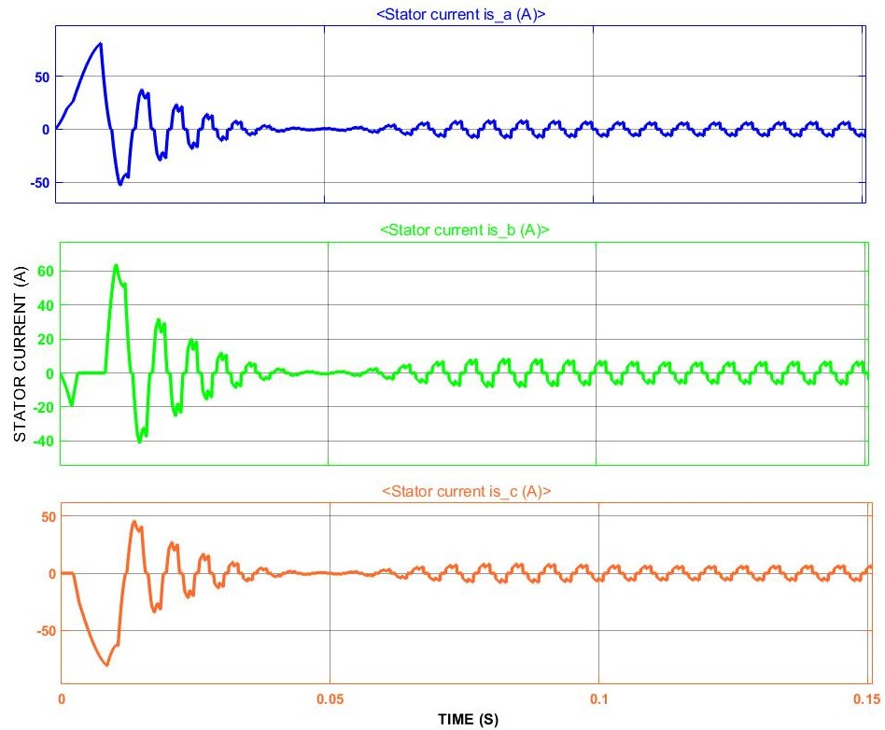
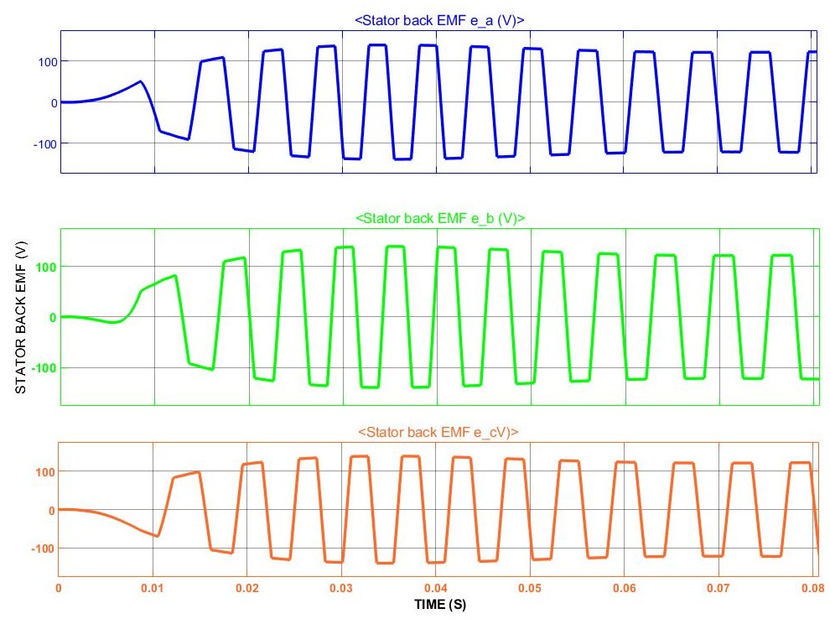
Cont.…

Slide 18
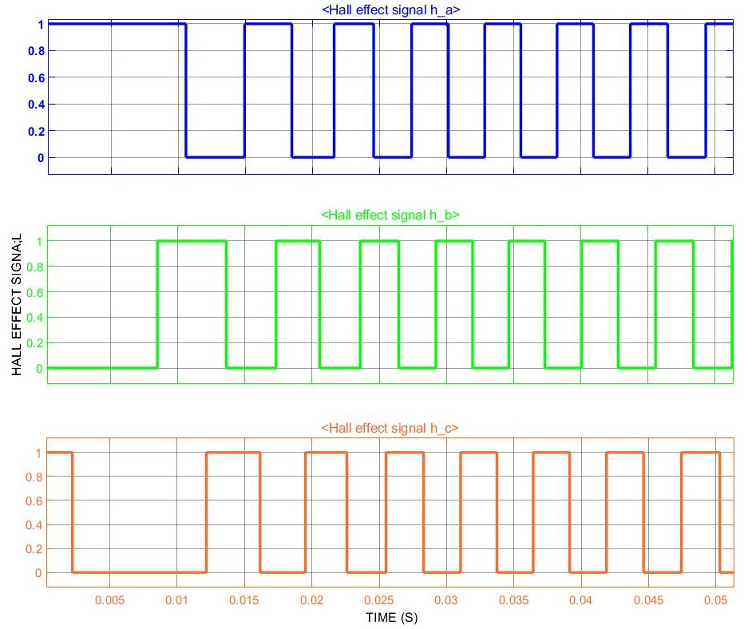
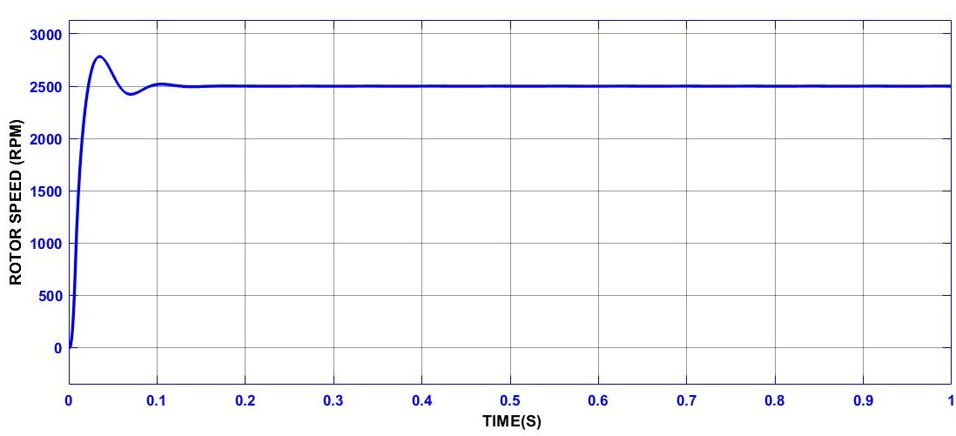
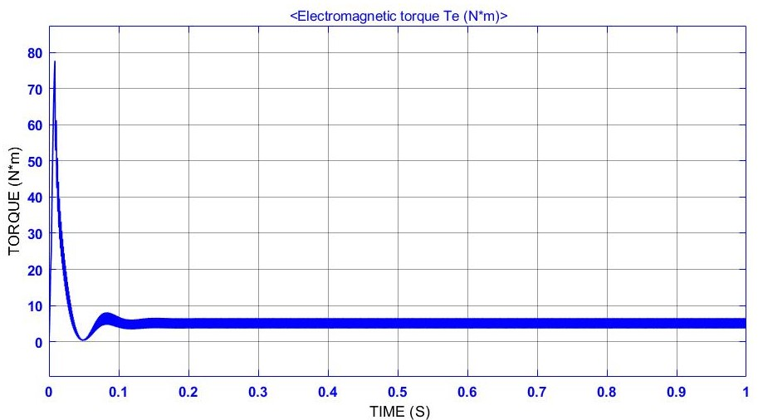
Cont.…

Slide 19
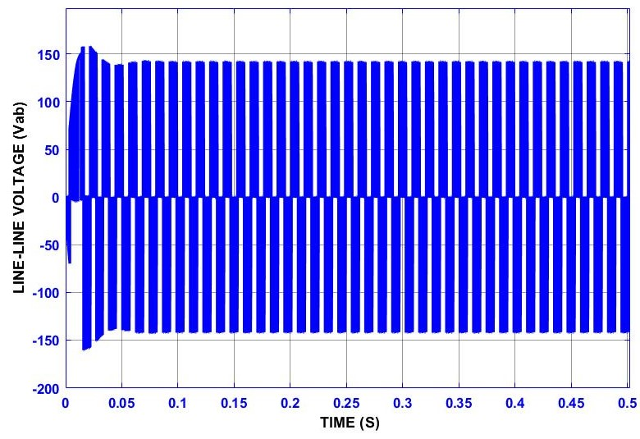
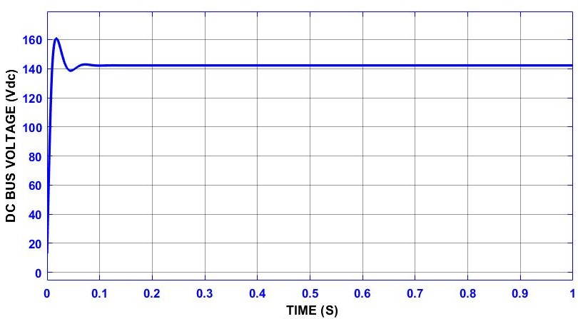
Cont.…
Case-3: Change speed from 2500 to 1250rpm:

Slide 20
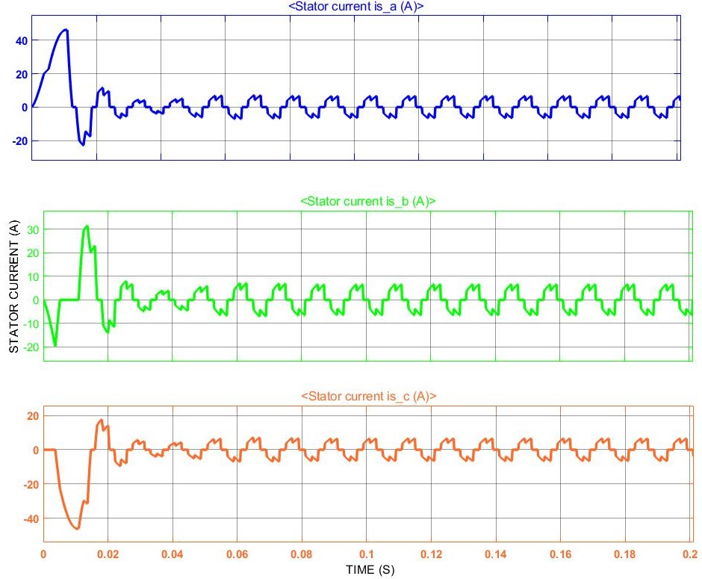
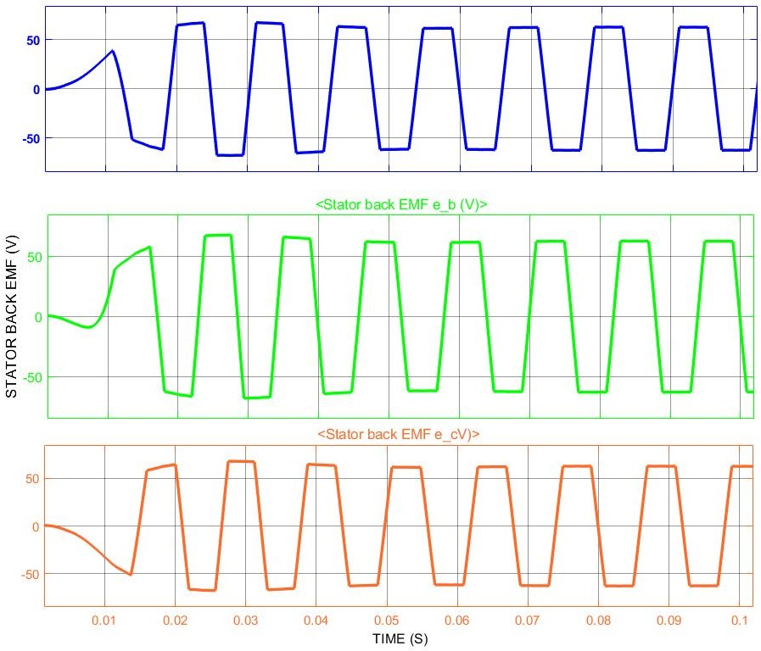
Cont.…

Slide 21
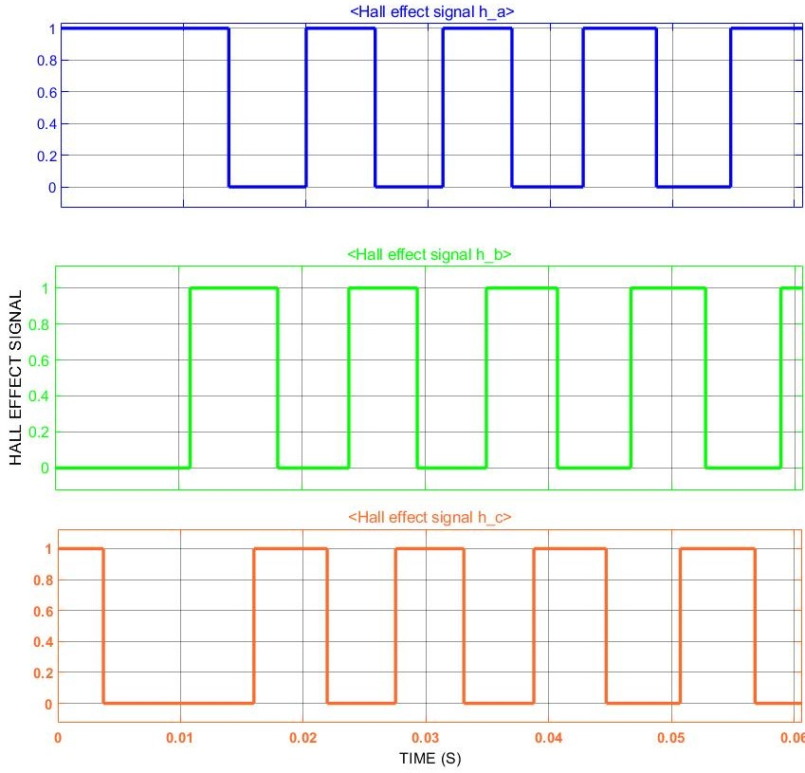
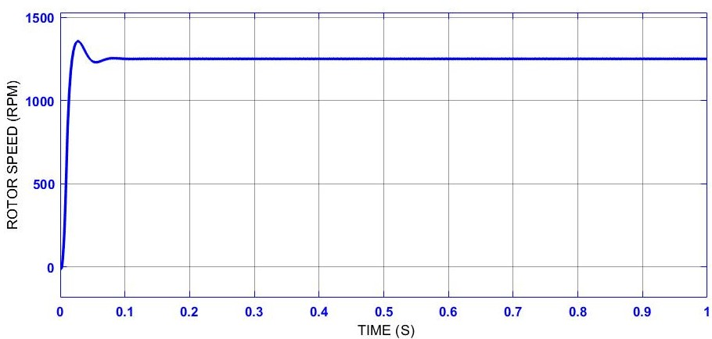
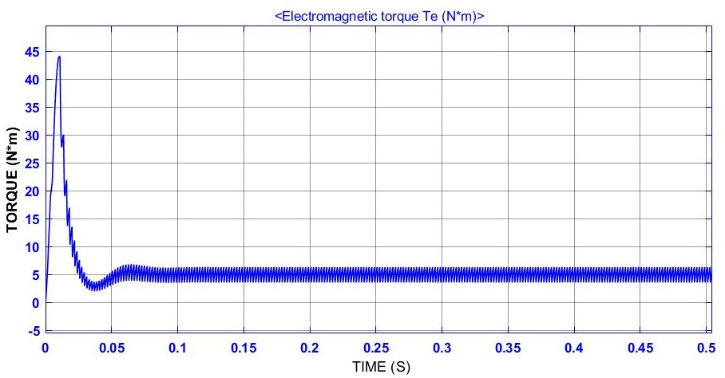
Cont.…

Slide 22
Cont.…
PARAMETERS |  | 1000RPM | 1250RPM | 2500RPM
Vdc | MAX | 129.1V | 160.8V | 338.7V
 | MEDIAN | 115.4V | 142.3V | 276.8V
 | MIN | 112.9V | 138.7V | 260.1V
Vab | MAX | 127.6V | 157.9V | 337.8V
 | MEDIAN | 114.4V | 141.3V | 276.8V
 | MIN | 111.9V | 137.9V | 259.9V
TORQUE | MAX | 36.53Nm | 44.06Nm | 76.1Nm
 | MEDIAN | 5.082Nm | 5.137Nm | 5.141Nm
 | MIN | 2.765Nm | 2.437Nm | 2.189Nm

Slide 23
ACKNOWLEDGMENT(S)
Dr. MAHESH KRISHNAMURTHY, Professor of ECE dept., ILLINOIS TECH.
IEEE Xplore
International Research Journal of Engineering and Technology (IRJET)
MATHWORK, MATLAB/SIMULINK

Slide 24
CONCLUSION
BLDC motor is highly reliable since it does not have any brushes to wear out and replace. When operated in rated conditions, the life expectancy is over 10,000 hours. For long term applications, this can be a great choice. Although a BLDC motor may cost more than a brushed DC motor, but often it will pay more than for itself in the amount of work time saved.
After performing our BLDC motor drive at targeted speed levels, we observed our motor is fully capable and controllable to operate at assigned speed levels. This is drive system is designed based up on maximum lower torque configuration which is better as compared to motors with maximum higher torque. All the simulation results are of theoretical aspects and can be utilized for practical implementation. If the above proposed drive model brought in USA; it may cost between 1000USD to 1200USD according to our mentioned specification.

Slide 25
CITATION(S)
[1]T. Raghu, S. Chandra Sekhar, J. SrinivasRao, ―SEPIC Converter based-Drive for Unipolar BLDC Motor‖, International Journal of Electrical and Computer Engineering (IJECE), Vol.2, No.2, April 2012, pp. 159-165 .
[2] A. HalvaeiNiasar, AbolfazlVahedi, Hassan Moghbeli, ―Torque Control of Brushless DC Motor Drive based on DSP Technology‖, Proceeding of International Conference on Electrical Machines and Systems 2007, Oct. 8~11, Seoul, Korea.
[3] F. Rodriguez and A. Emadi, ―A novel digital control technique for brushless DC motor drives,‖ IEEE Transaction Industrial Electronics., vol. 54, no. 5, pp. 2365–2373, Oct. 2007
[4] C. Gencer and M. Gedikpinar, ”Modelling and Simulation of BLDC Motor Using MATLAB/SIMULINK”, Journal of Applied Sciences, vol. 6, issue 3, pp. 688-691, 2006 .
[5] Vinod Kr Singh Patel, A.K. Pandey, “Modelling and Simulation of Brush less DC Motor Using PWM Control Technique”, IJERA Transaction, vol. 3, issue 3, May – jun 2013 .
[6] G. Prasad, N. Sree Ramya,” Modelling and Simulation Analysis of the Brush less DC Motor by using MATLAB”,IJITEE Transaction, vol. 1, issue 5 October 2012 .
[7] A. Purna Chandra Rao, Y.P. Obulesh and Ch. Sai Babu, ”Mathematical modeling of BLDC Motor with closed loop speed control using PID controller under various loading conditions”, ARPN Journal of Engineering and Applied Sciences, vol. 7, no. 10 October2012 .
[8] IJECSCSE, Digital Control of BLDC Motor Using Hall Sensor, G.Premkumar.

Slide 26

Q & A

Slide 27

THANK YOU

